Slide 1
RAIDERS U13 Team 1
2023-2024
Team Guide

Slide 2
Team Roster
RAIDERS U13 Team 1 2023-2024 Team Guide
Forwards
Defense
Staff
# | Player Name
2
3
4
6
8
10
13
15
16
17
# | Player Name
7
9
11
14
Name | Position
 | Head Coach
 | Assistant Coach
 | Assistant Coach
 | Assistant Coach
 | Assistant Coach
 | Team Manager
Goalies
# | Player Name
31

Slide 3
Team Mission & Core Values
RAIDERS U13 Team 1 2023-2024 Team Guide
MISSION
The Raiders Hockey Club strives to create a hockey environment that is safe, inclusive and fair with a focus on development, teamwork, and sportsmanship for all members. We will anchor ourselves in our core values striving to be exemplary both on and off the ice in the spirit of competition. We are committed to provide a rewarding, fun and positive hockey experience for all while building a culture of success on and off the ice.
CORE VALUES
Integrity:
Honest and ethical behaviour will be exercised at all times and at all levels of the association.
Leadership:
We strive to achieve success both on and off the ice by inspiring confidence in our players and membership.
Respect:
We will follow the Raiders Hockey Club Code of Conduct and treat our teammates, opponents, coaches, officials, and administrators as we would want ourselves to be treated.
Health/wellness & safety:
We will provide a safe environment for players and coaches that will support their physical and emotional well-being.

Slide 4
Team Rules
RAIDERS U13 Team 1 2023-2024 Team Guide
Team Rules | Rule Enforcement
Respect your teammates, coaches, officials, opponents and parents. No swearing or offensive language. Please be at the rink 45 mins before game time for warmup. Locker room is for players and staff only. Absolutely no bullying, fighting or name calling…we are a team! Leave areas cleaner than you arrived- dressing room and other areas where we host team events. I will listen to my coaches and do my best at all practices and games. Practices are mandatory. No shooting pucks at a goalie’s back or head (and be aware of other players and coaches). | I will take personal responsibility for my own conduct. I choose how I will behave; my coaches are not responsible for how I act. If I choose to ignore our team rules the following will apply: A verbal warning Sit one shift Sit one period Sit one game + Coach/Parent Meeting

Slide 5
Team Goals
RAIDERS U13 Team 1 2023-2024 Team Guide
To provide the best possible team experience for all. When the season is over, we want the kids to NOT want to leave their teammates because they had so much FUN and had a great season.
Use the most of our practice time to develop our hockey skill and IQ, so that we become better athletes, improved hockey players and contribute to our teams successes.
Improve as a team every game, so our last game is our best. This will be based on specific game goals related to discipline, accountability and effort.

Slide 6
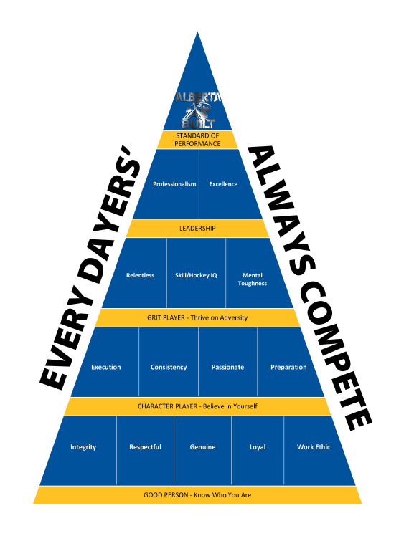
Player of the Month
RAIDERS U13 Team 1 2023-2024 Team Guide
This year RAIDERS HOCKEY CLUB is introducing the Player of the Month program. Each month one player from each level (U11, U13, U15 etc.) will be selected as Player of the Month for that level and will be awarded a $100 GC to Tuxedo Source for Sports.
U13-1 will be nominating our players based on the Hockey Alberta Standard of Performance Pyramid. Our nominees will exhibit characteristics found in the bottom two layers of the pyramid.
Good Person | Character Player
Integrity | Execution
Respectful | Consistency
Genuine | Passionate
Loyal | Preparation
Work Ethic
Peewee 3 Black’s team captains will be selected using the same criteria.

Slide 7
RAIDERS U13 Team 1
2023-2024
Team Principles

Slide 8
On-Ice Identity
RAIDERS U13 Team 1 2023-2024 Team Guide
We own the puck! - When we have it, we protect it, and when we don’t, we go get it. Possession is King.
Pressure, Pressure, Pressure! - We don’t stop skating, keep our legs moving, and we put continuous pressure on our opponents.
Short shifts, Smart Changes – Shifts are 30-45 Seconds, We make smart and timely changes, don’t leave our teammates in a bad spot.
Pucks over the Blues – We get the puck out of our zone and we get the puck deep into the other zone.
Protect the House! – D-side positioning, Mid Ice Strong, Big Goaltending
Forecheck with Purpose – F1 goes directly to where the puck is, not where it might be going.
Backcheck All The Way - “BC-ATW”- Backcheck through the middle all the way
Our D are a part of our OFFENSE!! - They rush we cover, they’re open we pass to them, they’re shooting we screen.

Slide 9
Defensive Principles
RAIDERS U13 Team 1 2023-2024 Team Guide
Play Mid ice strong - We play between the dots and protect this ice first before moving out.
Win battles and be first to loose pucks – We battle hard and we win the races to 50/50 pucks. We must own the puck!!!
We get our sticks on pucks – We use skating and active sticks to disrupt our opponents to force turnovers.
D-Side Positioning – We are always defensively on the correct side of our opponent interrupting their passes and shots.
Maintain our Composure – If we find ourselves in trouble we fallback to our defensive structure. We don’t scramble!
Rebound Control – Our goaltending controls rebounds, our team collapses to support our goaltending.

Slide 10
Breakout Principles
RAIDERS U13 Team 1 2023-2024 Team Guide
Transition quickly: The best breakouts are the ones that move quickly after getting the puck back.
A sense of urgency is needed: Pucks move hard and quick. Feet move up ice.
Communication: All players must be talking and helping each other out.
All players have a role:
Wingers low and wide in zone: create as much width as possible stay low and wide to create passing options
Center low and slow through middle: Make yourself an option as well for a pass from D
Defence move yourself and the puck: Make sure you are moving your feet while looking to pass. D to D’s are great options if done quickly and effectively
Goalies communicate options and setup puck behind the net for the defence
Pucks at bluelines. These must get out. Center and weak side wingers slide over to the blue line battle and help get pucks OUT!!!

Slide 11
Special Teams
RAIDERS U13 Team 1 2023-2024 Team Guide
Power Play
Possession over Position- In order to score you must have the puck. Go help in battles for puck- Always have one more guy than the opposition.
Support- We must be in good places to support the puck. Create passing options for the puck carrier.
Move the puck- This is contingent on 1 and 2. The puck is the fastest thing on ice so we must move it to keep the opposition out of position.
Pucks and Bodies to Net- You can only score if you shoot the puck, simple but effective. Send bodies to the net on shots for rebounds. Dirty goals wins games!!!
Penalty Kill
Discipline: The best penalty kills are the ones we don’t have to kill at all!!
Getting 50/50 pucks: If a puck is loose or the opposition is losing control, we can pressure them more and get pucks cleared.
Active sticks: Getting sticks on Pucks disrupts the offense. Any passes or opportunities to poke check must be made.
Short Movements: When the opposition has the puck, use short movements to keep them outside
Block shots and be Relentless

Slide 12
Offensive Principles
RAIDERS U13 Team 1 2023-2024 Team Guide
Chip n’ Chase – Dump the puck in and go get it. Forecheck relentlessly to win the 50/50 pucks or create an offensive zone turn-over.
Go wide and get to the paint! – When carrying the puck move through the neutral zone on the outside and drive to the net once in the offensive zone.
Hit the Net! – We must make the most of the shots we get. We can’t score if we miss the net.
Follow our shot – Follow our shot to the net to seek out rebounds
Create traffic and chaos – Make life difficult for the opposing goalie get bodies to the net when our teammates are shooting
Puck movement – Keep the puck moving until a good scoring opportunity arises. Skating and Passing are key elements to creating scoring opportunities.

Slide 13
RAIDERS U13 Team 1
2023-2024
Season View

Slide 14
Key Dates
RAIDERS U13 Team 1 2023-2024 Team Guide
October
November
December
January
February
March
Seeding Round
October 18th – December 8th
Coach Checkpoint on Season Development / Team Guide
EMHW
January 11th, 2020
Regular Season
October 16th – December 8th
City Championships
Invermere Tournament
October 11th – 13th
Our Tournament
December 9th – 12th

Slide 15
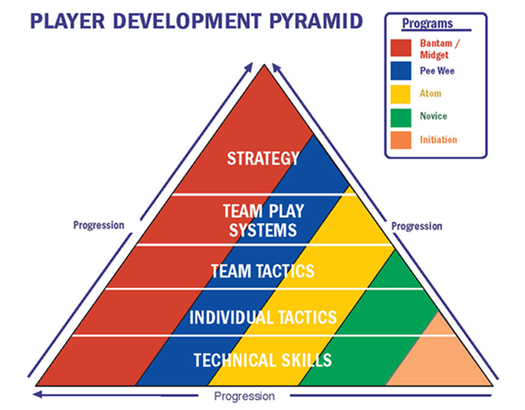
Year Long Development Plan
RAIDERS U13 Team 1 2023-2024 Team Guide
October
November
December
January
February
March
Skating
Skating
Individual Tactics
Positioning / Movement
Team Tactics
Save Selection
Team Systems
Puck & Rebound Control
Skaters
Strategy
Goalie

Slide 16
RAIDERS U13 Team 1
2023-2024
Off Ice

Slide 17
Pre-Game Warm-up Routine
RAIDERS U13 Team 1 2023-2024 Team Guide
Before each game U13-1 will arrive at the arena 45 minutes before the game. As a team we will find a good location and perform the following warm-up routine. Performing this routine ensures we are ready to hit the ice with our minds and bodies ready to perform at peak levels.
Stretching | Warm-up
Arm Circles | Knee Highs
Trunk Rotations | Butt Kicks
Groin Stretch | Karaoke's
Side Lunge | Lunges
Hamstring / Lower Back | Gate Openers
Squats | Sprint

Slide 18
Hockey Alberta Performance Enhancers
RAIDERS U13 Team 1 2023-2024 Team Guide
Sleep | Hydration | Post Work-Out Snack or Drink
Sleep is called "The Athlete's Steroid" because when player's get good sleep they release human growth hormone which helps build muscle and improves strength/power. Young players should be getting around 8.5 - 10 hours of sleep. Research shows that when athletes get 10 hours of sleep they swim faster, run faster, and shoot basketballs more accurately. | Hydration Players can tell if they're properly hydrated if their urine is clear. Best to sip fluid throughout the day. When a player is well hydrated, training feels easier, the heart works better, and heat is lost better. Sports drinks offer some carbohydrates for the muscles and sodium and potassium to help with muscle contraction. | Best to eat or drink something within 2 hours after a practice, work-out, or game. This starts the process of repairing the muscles and getting carbohydrates & protein into the muscles . . . to get ready for the next work-out. Best to eat or drink something with carbohydrate and protein . . . therefore Chocolate Milk is such a good post work-out drink.

Slide 19
Hockey Alberta Nutrition for Young Players
SVHA U13 Team 1 2023-2024 Team Guide
Game Day Nutrition | Challenges & Possible Solutions | Examples of Meals from Breakfast to Post-Game, Food to Avoid & Timing
On game day everything counts and athletes must eat well to perform at their highest level, on demand and from beginning to end. Drink water, not sugar drinks. It’s important for your child to day hydrated for practices and games, and water is generally the best choice. Avoid soda beverages and sport drinks that are full of sugar. Eat balanced meals. During the day, make sure your child eats from all the essential food groups (fruits, vegetables, grains, lean meats, meat substitutes, dairy, healthy fats). It’s not necessary to incorporate everything into each meal, but your child should eat some of these items each day. | If a player has low energy and is losing mental focus they should be provided with fuel such as fresh fruit, a sport drink, unsweetened juice or a granola bar. Quality ingredients provide quality nutrition. Given the choice between processed flour or whole grains, choose whole grains. Rather than processed fruit snacks, eat whole fruits. In general, stick with unprocessed whole foods and avoid processed packaged items as much as possible. | Eat carefully on the road. When possible, stop at a grocery store and eat fresh from the deli department, or create your own healthy meals with whole grain breads, meats, nuts, cheeses, vegetables, and fruit. If you know you will be eating at a restaurant, do some research ahead of time to find places that serve balanced meals and healthy food. Avoid fried foods and sugary sauces. Fried foods are difficult to digest in general, and they often feature unhealthy trans fats if you are eating at a restaurant or a concession. Similarly, many sauces and dressings from restaurants and stores are full of unhealthy sugars, hydrogenated oils, and chemical additives. Either reduce the serving portions of these sauces and dressings or create healthy alternatives at home using olive oil and natural ingredients.

Slide 20
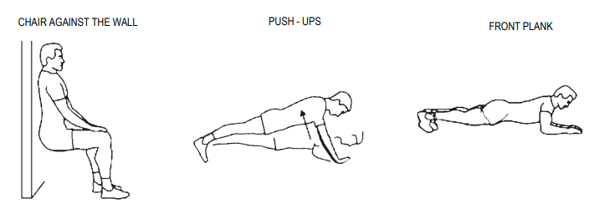
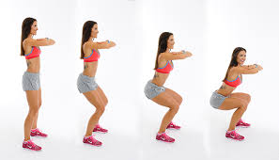
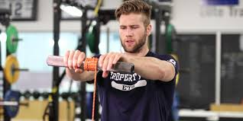
Hockey Development Doesn’t Stop at Rink
RAIDERS U13 Team 1 2023-2024 Team Guide
While most of our hockey development happens on ice there is still a lot that can be done to improve your overall health and athletic skills off-ice. By performing basic strength training, yoga stretching, and specific off-ice training you can improve your overall athletic performance, lower your chances of injury, and become a better overall hockey player. Below are a list of activities that you can perform when away from the rink. Ask coaches for more information on each of these and for other training activities you can do outside the rink.
Stretching | Basic Strength Building |  | Dryland Hockey Skills
All pre-game stretching | Push-ups | Wall Sits | Golf Ball Stick Handling
Any yoga | Planking | Forearm & Wrist Rolls | Shooting
Google Hockey Canada Stretching | Squats (1 & 2 leg) | Running Stairs | Ladder

Slide 21
1st Half Captains Vote Card
Please select 3 names from the list below to represent our team as captains for our 1st half of the season. Please remember to think about the Hockey Alberta Pyramid when making your selection. The coaches are looking for Team Leaders; Integrity, Respectful, Genuine, Loyal, Work Ethic and Character Players; Execution, Consistency, Passionate, Preparation.
Additional Comments: _________________________________________
____________________________________________________________
____________________________________________________________

