Slide 1
RAIDERS U15 BC2
2023-2024
Team Guide

Slide 2
Team Roster
Raiders U15 BC2 2023-2024 Team Guide
Forwards
Defensemen
Staff
# | Player Name
10
16
7
15
12
9
17
2
4
8
# | Player Name
21
5
11
18
6
14
Name | Position
 | Head Coach
 | Assistant Coach
 | Assistant Coach
 | Assistant Coach
 | Assistant Coach
 | Manager
Goalies
# | Player Name
31
1

Slide 3
Team Mission & Values
Raiders U15 BC2 2023-2024 Team Guide
MISSION
The Raiders Hockey Club strives to create a hockey environment that is safe, inclusive and fair with a focus on development, teamwork, and sportsmanship for all members. We will anchor ourselves in our core values striving to be exemplary both on and off the ice in the spirit of competition. We are committed to provide a rewarding, fun and positive hockey experience for all while building a culture of success on and off the ice.
CORE VALUES
Integrity:
Honest and ethical behaviour will be exercised at all times and at all levels of the association.
Leadership:
We strive to achieve success both on and off the ice by inspiring confidence in our players and membership.
Respect:
We will follow the Raiders Hockey Club Code of Conduct and treat our teammates, opponents, coaches, officials, and administrators as we would want ourselves to be treated.
Health/wellness & safety:
We will provide a safe environment for players and coaches that will support their physical and emotional well-being.

Slide 4
Developing Leaders
Raiders U15 BC2 2023-2024 Team Guide
SVHA U15 BC2 coaches will name one Captain “C” and two Assistants “A” this season. Captains will be chosen by the coaches and will be announced at the appropriate time in the seeding round. Although we can only have a limited number of lettered Captains U15 BC2 coaches expect all of our players to demonstrate and grow their leadership qualities. These are the qualities of a good leader that coaches will use as a guide for the selection of our captains.
Quality | Description
Highly Motivated | While some players are able to get by with their natural talent and minimal effort, captains don’t fall into this trap. Even if they are the most skilled player on the team, the captain will be constantly working to improve his or her game on a daily basis. They are willing to show up early and study the other team or go over important drills and learn from past mistakes. To a captain, the most important thing is that the team gives its best effort, and he is prepared to motivate his teammates and often even his coaches in order to bring out everyone’s strengths.
Selfless | A captain isn’t just looking to be the stats leader at the end of the season – he wants to see all of his teammates play to the best of their ability. This means being selfless and giving someone else an opportunity when the situation calls for it. A selfish player might see a small opening on the ice and attempt to shoot their own goal when a much better option was right in front of them. A good captain knows that he should pass in this situation as it gives the team a better chance to score and possibly win the game. This selflessness doesn’t only show during the game, either. Captains will stick around and help younger or less experienced players with their drills and practices. The captain is there to motivate not only himself but every other player on the team. He will be focused on growth and learning and willing to give his time to the team in order to help others. The success of the team is far more important than that of the individual, and the captain is well aware of this. He’d much rather see a “W” for the team than a hat trick for himself.

Slide 5
Developing Leaders Continued…
Raiders U15 BC2 2023-2024 Team Guide
Quality | Description
Positive Reinforcement | Negative comments and pessimism are contagious and can result in the entire team playing below their standards. If someone takes a bad shot and gets reamed out by their teammates, they may become angry or lose confidence. This can cause them to start playing worse throughout the game even if they hardly made a mistake in the first place. A good team captain is aware of this and does everything possible to focus on the positive aspects of the game. Instead of dwelling on what went wrong with a certain play, the captain might compliment the initial move or the excellent skating skills shown by the other player. He will discuss what can be changed next time in order to succeed rather than continuing to highlight why the team failed previously. Encouraging a stronger performance always yields better results than putting teammates down and dwelling on poor ones. This starts small with every play on the ice but must also be followed throughout the course of the season. Losing four in a row isn’t an ideal situation for any team, but a captain knows how to rally them together and get everyone looking forward to the next game instead of thinking about the past.
Humble but Strong | While there is nothing wrong with a good goal celebration, a good captain knows not to get too emotional in any aspect of the game. He can have fun with his team and enjoy the victories, but he must maintain a steady, humble but strong presence that keeps the team on an even level. This can be a challenge when everyone is celebrating an overtime victory, but it is a major asset when a team is down multiple goals in a physical and chirpy game against one of its rivals. Instead of succumbing to emotion and taking a bad penalty or starting a fight, a captain knows to focus on the game and remain undistracted. When the captain can show this kind of resolve, the team is likely to follow suit. Negative emotions should be channeled into a burst of energy to get the team working together again. A captain will not let a bad situation get the best of him, and his teammates will respect him for keeping his head in the game in the face of adversity.
Learns from Mistakes | Many players continue to try to the same technique over and over even when it isn’t working. They may become frustrated and unable to understand why they can’t get their plan to work. The right team captain knows that mistakes will be made and that he must adjust in order to overcome them. This ability to learn from mistakes is one of the strongest traits that a captain can show his team, and he must impart his knowledge to his teammates at every opportunity. Whether it’s something as small as poor footing leading to an inconsequential turnover or a sloppy pass that leads to the game-ending goal for the other team, a good team captain is always analyzing his and others’ mistakes. This allows him to evaluate the cause of the problem and come up with a fix for it the next time it happens. It isn’t so much dwelling on mistakes as it is learning from them, and that is extremely important for any athlete. Even if his play caused a team to lose the championship game, he sees it as a learning experience that he can take into the next season.

Slide 6
Team Rules
Raiders U15 BC2 2023-2024 Team Guide
Practice | Games | Rule Enforcement
Practices are mandatory, not optional | Dress Code: Pro Casual, Storm Toques, No Hats | Players will take personal responsibility for their own conduct. They choose how they behave and understand that their coaches are not responsible for how they act. If they choose to ignore our team rules the following will apply: 1st Offence - A verbal warning 2nd Offence - Sit one shift 3rd Offence - Sit one period 4th Offence - Sit one game + Coach/Parent Meeting
No shooting pucks at a goalie’s back or head (and be aware of other players and coaches). | On Time: Pre-game warm-up starts 45 minutes before game time, coach time 10 minutes before puck drop
Dressed and ready to be on the ice once at start of our ice time | Your equipment is your responsibility, this includes your pre-game warm-up gear and all hockey equipment
All players will wear white socks with their practice jerseys
General
Respect your teammates, coaches, officials, opponents and parents.
No swearing or offensive language.
Locker room is for players and staff only.
Listen to my coaches and do my best at all practices and games.
Absolutely no bullying, fighting or name calling…we are a team!
Leave areas cleaner than you arrived- dressing room and other areas where we host team events.

Slide 7
Raiders U15 BC2
2023-2024
Team Principles & Systems

Slide 8
On-Ice Identity
Raiders U15 BC2 2023-2024 Team Guide
We own the puck! - When we have it, we protect it, and when we don’t, we go get it. Possession is King.
Pressure, Pressure, Pressure! - We don’t stop skating, keep our legs moving, and we put continuous pressure on our opponents.
Finish our Checks – Hit what we should and not what we can. Separate man from puck and make it uncomfortable.
Short shifts, Smart Changes – Shifts are 30-45 Sec. We make smart and timely changes, don’t leave our teammates in a bad spot.
Pucks over the Blues – We get the puck out of our zone and we get the puck deep into the other zone.
Protect the House! – D-side positioning, Mid Ice Strong, Big Goaltending
Communicate, Communicate, Communicate! – We use our voices on the ice, calling for passes and making our teammates aware
Backcheck All The Way - “BC-ATW”- Backcheck through the middle all the way
Our D are a part of our OFFENSE!! - They rush we cover, they’re open we pass to them, they’re shooting we screen.

Slide 9
Defensive Principles
Raiders U15 BC2 2023-2024 Team Guide
Outnumber & Overload – We defend by attacking with pressure and numbers, 2 on 1’s, 3 on 2’s. F1 attack, F2 Support…
Play Mid ice strong - We play between the dots and protect this ice first before moving out.
Win battles and be first to loose pucks – We battle hard and we win the races to 50/50 pucks. We must own the puck!!!
We get our sticks on pucks – We use skating and active sticks to disrupt our opponents to force turnovers.
D-Side Positioning – We are always defensively on the correct side of our opponent interrupting their passes and shots.
Maintain our Composure – If we find ourselves in trouble we fallback to our defensive structure. We don’t scramble!
Rebound Control – Our goaltending controls rebounds, our team collapses to support our goaltending.

Slide 10
Breakout Principles
Raiders U15 BC2 2023-2024 Team Guide
Transition quickly - A sense of urgency is needed when transitioning: Pucks move hard and quick north bound. Feet move up ice.
Don’t Panic – Keep your cool, slow it down, settle the puck. Make good passes.
Communication - All players must be talking and helping each other out.
All players have a role – Breakout as a 6 Man Unit
Wingers low and wide in zone: create as much width as possible stay low and wide to create passing options
Center low and slow through middle: Make yourself an option as well for a pass from D
Defence move yourself and the puck: Make sure you are moving your feet while looking to pass. D to D’s are great options if done quickly and effectively
Goalies communicate options and setup puck behind the net for the defence
Pucks at bluelines must get out – Support each other, be firm with passes, don’t be cute, Get it OUT!!!

Slide 11
Offensive Principles
Raiders U15 BC2 2023-2024 Team Guide
Aggressive Forecheck - Play the system 2-3 Press Forecheck. Meet or Beat to pucks and overload with F1 – F2.
Net Drive – Get you or the puck to the middle of the ice, use F3 in slot/high-slot.
Hit the Net! – We must make the most of the shots we get. We can’t score if we miss the net.
Follow your shot – Follow our shot to the net to seek out rebounds, play to the whistle.
Create traffic and chaos – Make life difficult for the opposing goalie, take the eyes away, get bodies to the net.
Puck movement – Keep the puck moving until a good scoring opportunity arises. Make the other goalie move side to side, Pass!
Communicate – Talk, Call for passes, Let a teammate know your F1 and he’s F2, Use code words
5 Man Unit - Use our Defencemen in the offensive zone.

Slide 12
Forecheck Principles
Raiders U15 BC2 2023-2024 Team Guide
Commit to the System – Our forecheck will only work if all 5 players work together and support each other.
Inside Out Attack Angle – We attack with an inside out angle. We want to force our opponents towards the boards and corners.
Outnumber – We always attack with more numbers and overload the opponent. When there is a puck carrier moving the puck we make it a 2 vs 1 in our favour. When the puck is on the boards in a 2 vs 2 battle we send in support to make it a 3 v 2 battle.
Forecheck in all Zones – Our forecheck principles are applied in all three zones. Our forecheck is how we get the puck back.
Close the Gap and Take away Space – Quickly and aggressively get after our opponent when they have the puck. Don’t sit back and watch, get on your toes and go take it back.

Slide 13
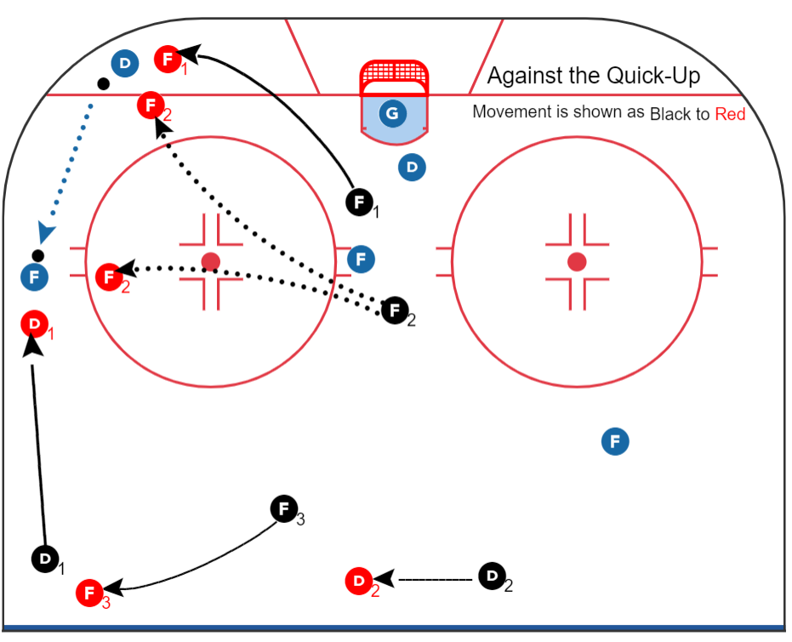
2-3 Press Forecheck vs. Quick Up & Rim
Raiders U15 BC2 2023-2024 Team Guide
Overload & Outnumber!
F1: Attacks from an inside out direction forcing opposing puck carrier up their boards. Take away the defenceman’s “safe zone”.
F2: Overloads to create 2 on 1 by supporting F1 or D1. Make a quick decision and be aggressive.
F3: Covers both defencemen when they pinch and is ready to become a scoring option if F1 and/or D1 can turnover the puck.
D1: Aggressively pinches down the boards to take away space from the opposing Winger. Take a slight inside out approach to ensure opponent can’t get to the middle of the ice.
D2: Ensures mid-ice positioning when D1 pinches.

Slide 14
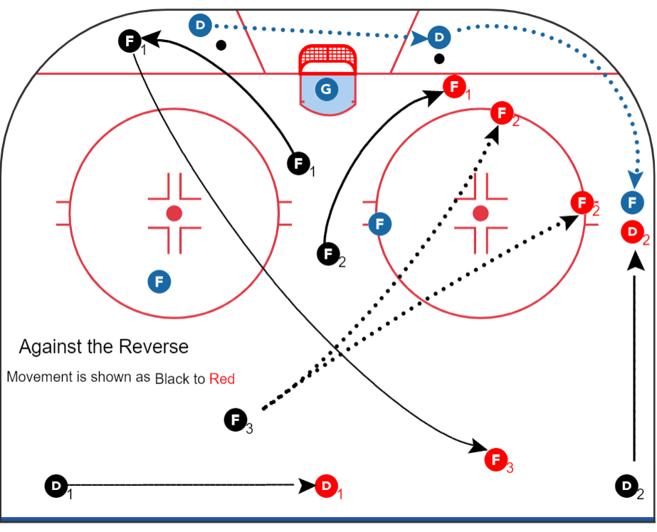
2-3 Press Forecheck vs. Reverse & D-Wheel
Raiders U15 BC2 2023-2024 Team Guide
Adapt & Overload & Outnumber
This scenario often means our F1 lost to their defencemen who is moving the puck now behind their net.
F1: Moves into F3 position covering D2 on pinch if required or moving into slot in event of a turnover.
F2: Becomes F1 and attacks puck carrier (opponents D).
F3: Becomes F2 and Overloads to create 2 on 1 by supporting F1 or D2. Make a quick decision and be aggressive.
D2: Aggressively pinches down the boards to take away space from the opposing Winger. Take a slight inside out approach to ensure opponent can’t get to the middle of the ice.
D1: Ensures mid-ice positioning when D2 pinches.

Slide 15
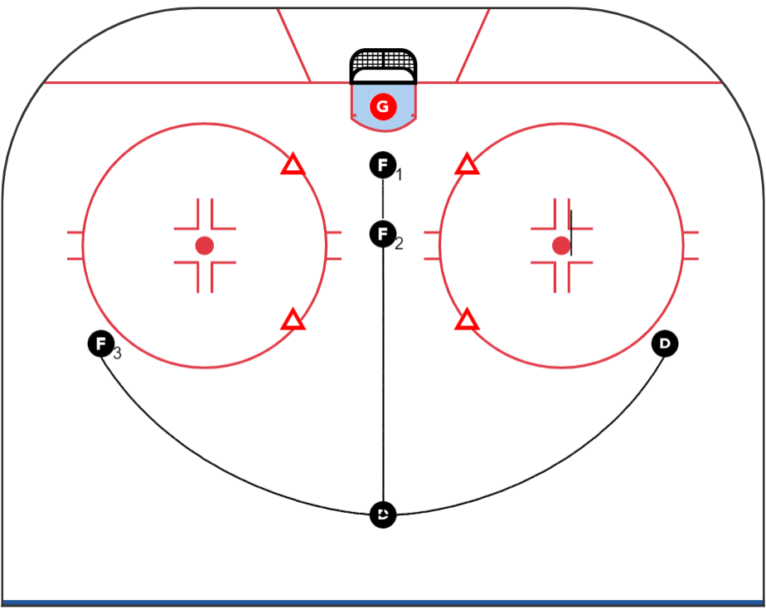
Special Teams – Umbrella Power Play
Raiders U15 BC2 2023-2024 Team Guide
Umbrella Power Play
The Umbrella is all about passing options, finding shooting lanes, and creating traffic in front of the net. The Umbrella provides the most options from the middle of the ice and is anchored by the player at the top of the umbrella.
Principles:
Move the puck around to get the goalie moving from side to side.
F1 and F2 are deflection and/or rebound options.
The “Stafford” is our go to once we setup.
If the other team gets the puck we attack and overload. Transition quickly to our forecheck.
In the Umbrella we are exposed defensively so be sure when moving the puck from down low to high

Slide 16
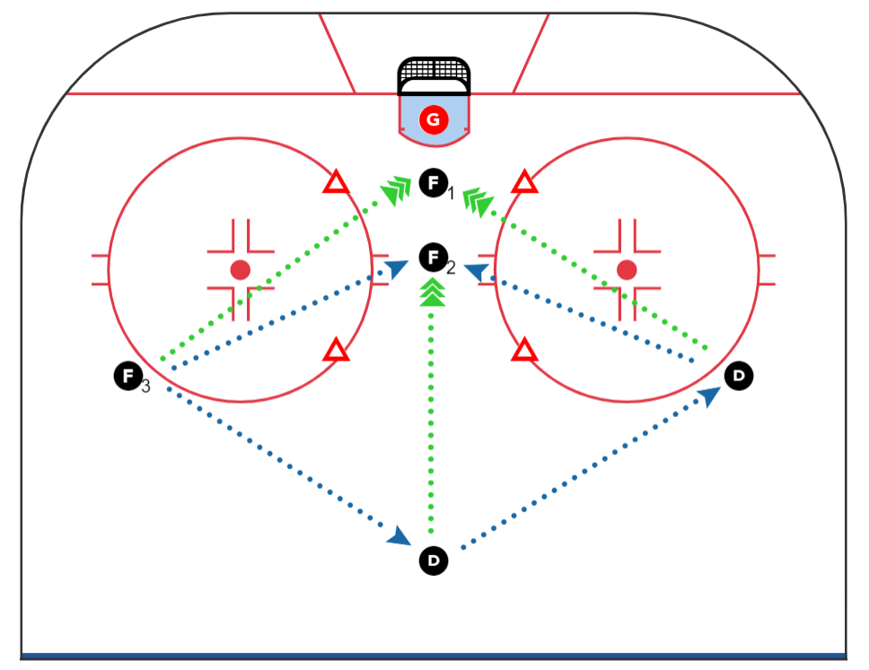
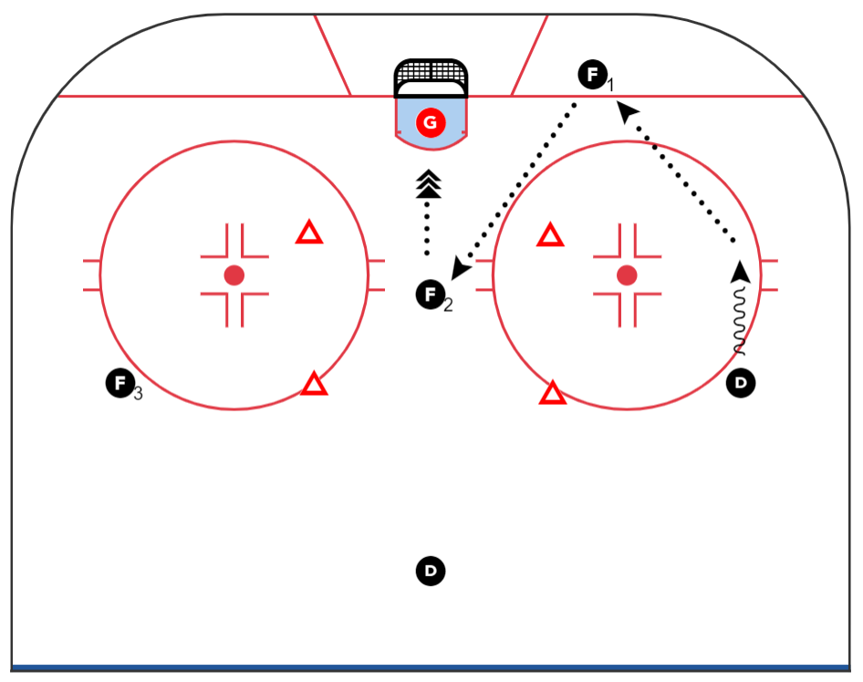
Special Teams – Umbrella Power Play
Raiders U15 BC2 2023-2024 Team Guide
The Umbrella is all about passing options, finding shooting lanes, and creating traffic in front of the net. The Umbrella provides the most options from the middle of the ice. When the puck ends up deep, corners, or the side boards we want to re-group to our umbrella and get the puck high. | “The Stafford”. (1) D slides down the boards, F1 drops below the goal line to provide passing option, F2 props up for one-timer shot from the slot. (2) D passes to F1, F1 then passes to F2 in slot. (3) F2 Fires quick shot from the slot.
21
1
2
2
3
1

Slide 17
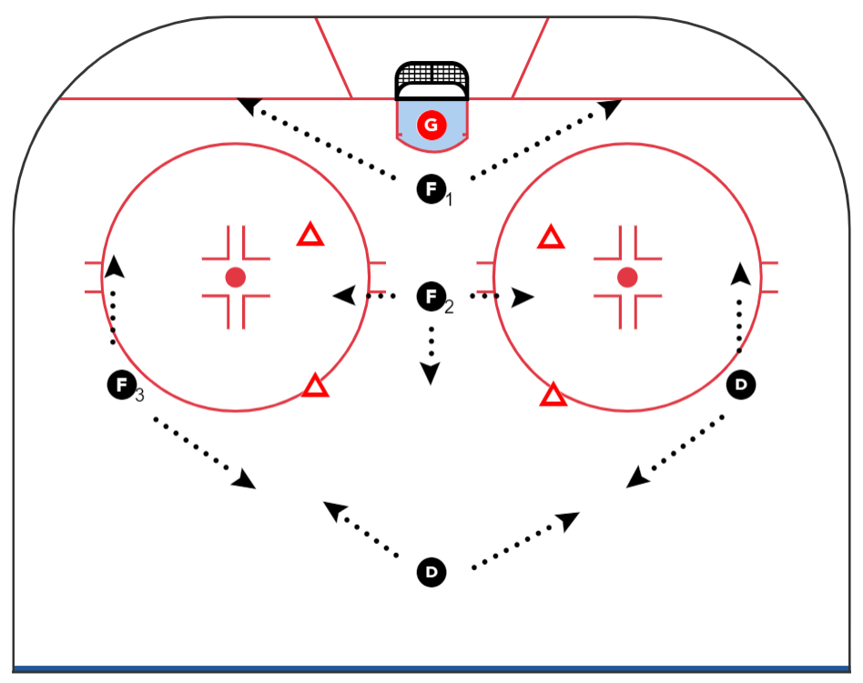
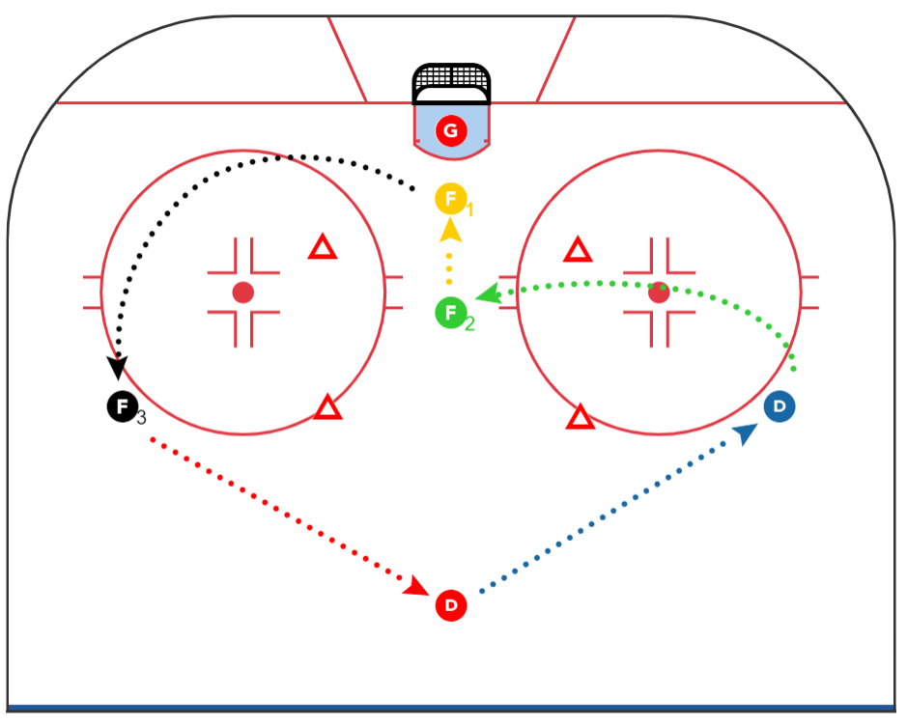
Special Teams – Umbrella Power Play
Raiders U15 BC2 2023-2024 Team Guide
Movement: We always “Overload” when we lose the puck. F1 covers corners and takes away the goalie's eyes. F2 stays high slot with stick ready for deflection or one-timer F3, D1, D2 float along top of the zone, cover side walls, and help in corners. | Cycling in the umbrella is all about keeping 3 players high and 2 players in front the of the net / slot. Below depicts what it might look like if F1 cycles out of the left corner with the puck. F1 to F3, F3 to D, D to D, D to F2, F2 to F1.

Slide 18
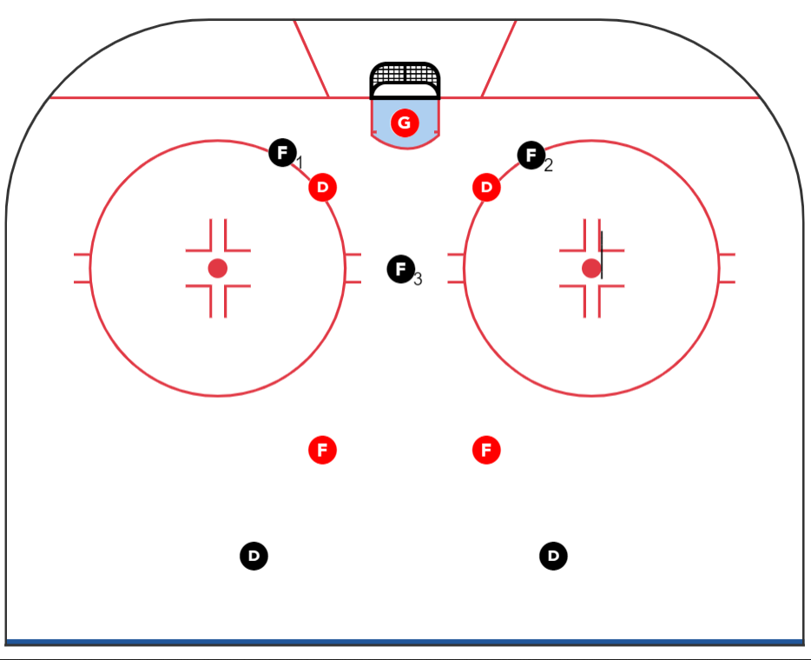
Special Teams – Penalty Kill
Raiders U15 BC2 2023-2024 Team Guide
Penalty Kill
Discipline: The best penalty kills are the ones we don’t have to kill at all!!
Win 50/50 pucks: If a puck is loose or the opposition is losing control, we can pressure them more and get pucks cleared.
Active sticks: Getting sticks on Pucks disrupts the offense. Any passes or opportunities to poke check must be made.
Short Movements: When the opposition has the puck, use short movements to keep the puck outside the box.
Have Purpose: Block shots, be Relentless, and maintain D-side positioning.
Short Shifts: Get out there, get the puck down and get off.

Slide 19
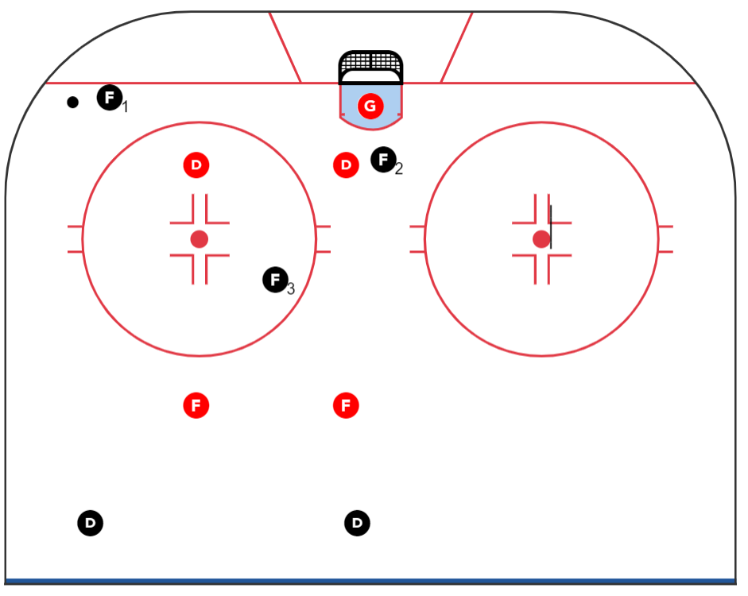
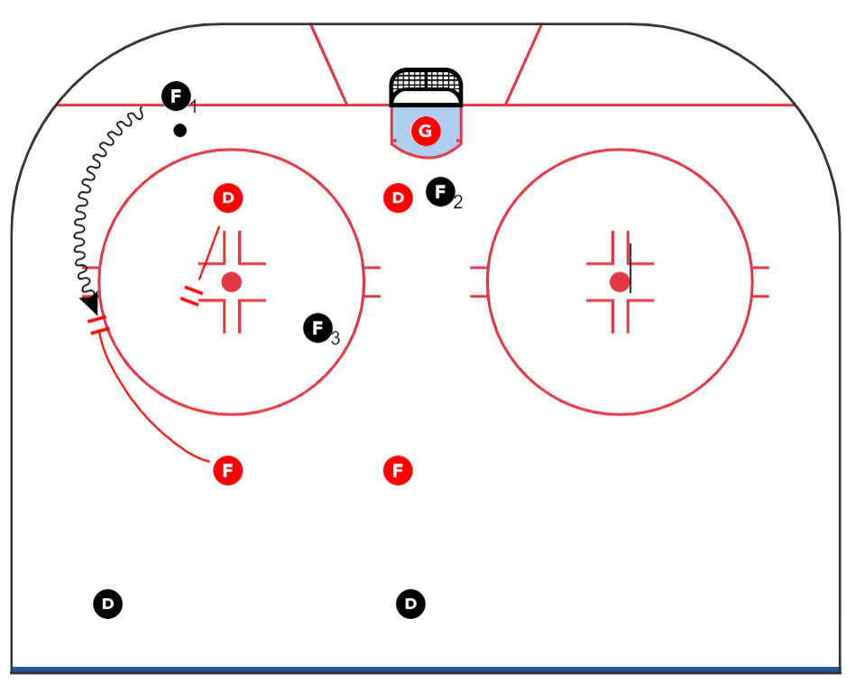
Special Teams – Penalty Kill
Raiders U15 BC2 2023-2024 Team Guide
Maintain our Box Structure as the puck moves around our zone. This ensures we keep our D-side positioning and keep the puck from getting into the middle of the ice. | If the opponent tries to move the puck up the side wall by skating our forwards will pressure downward while our defencemen pressures upward creating overload situation where we outman the puck carrier.

Slide 20
RAIDERS U15 BC2
2023-2024
Season View

Slide 21
Year Long Schedule Highlights
SVHA U15 BC2 2023-2024 Team Guide
Pre-Season
Seeding Round
Break
Regular Season
Break
Regular Season
Playoffs
Season End
Dec 9 – 11
Mar 24 - 26
Trailswest Tourney (Canal Flats)
Esso Minor Hockey Week
Stick it to Cancer Tourney
Jan 13 – 21
Evals
Dec 27 – 29
U15 BC2 Team Building
Springbank Tourney
City Champs
Exhibition
Wrap-up
Oct 22 – Nov 20
Dec 5 – Dec 21
Jan 6 – Feb 26
Nov 21 – Dec 4
Dec 22 – Jan 5
Feb 28 – Mar 22

Slide 22
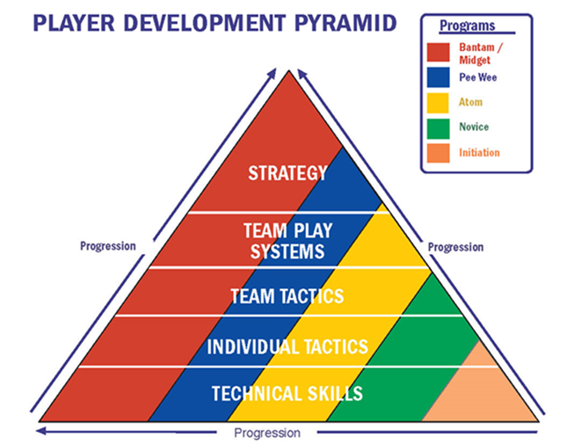
Year Long Development Plan
Raiders U15 BC2 2023-2024 Team Guide
Hockey Canada Development Pyramid
U15-BC2 will follow the Hockey Canada Development Pyramid for the season
Players can expect more development and focus on Team Play Systems along with Strategy
Team Play Systems help our team be successful in all the zones on the ice. To play successful hockey systems everyone must play a role and contribute.
Strategy helps us understand the why and teaches the little games with in the games that help us be better overall hockey players

Slide 23
RAIDERS U15 BC2
2023-2024
Off Ice

Slide 24
Pre-Game Warm-up Routine
Raiders U15 BC2 2023-2024 Team Guide
Before each game U15 BC2 will arrive at the arena and be ready for warm-ups 45 minutes before the game. As a team we will find a good location and perform the following warm-up routine (this might happen in our dressing room). Performing this routine ensures we are ready to hit the ice with our minds and bodies ready to perform at peak levels.
Setup: Requires approximately 10 - 12 yards of space to complete | Distance 10 - 12 Yards
1. High Knee Tuck | 7. Lunge
2. High Knee Run (Return) | 8. Reverse Lunge (Return)
3. Hurdler Stretch | 9. Open Gate
4. Butt Kick Run (Return) | 10. Close Gate (Return)
5. Figure 4 | 11. Low Lateral Shuffle
6. Straight Leg March (Return) | 12. Karaoke Shuffle (Return)

Slide 25
Hockey Alberta Performance Enhancers
Raiders U15 BC2 2023-2024 Team Guide
Sleep | Hydration | Post Work-Out Snack or Drink
Sleep is called "The Athlete's Steroid" because when player's get good sleep they release human growth hormone which helps build muscle and improves strength/power. Young players should be getting around 8.5 - 10 hours of sleep. Research shows that when athletes get 10 hours of sleep they swim faster, run faster, and shoot basketballs more accurately. | Players can tell if they're properly hydrated if their urine is clear. Best to sip fluid throughout the day. When a player is well hydrated, training feels easier, the heart works better, and heat is lost better. Sports drinks offer some carbohydrates for the muscles and sodium and potassium to help with muscle contraction. | Best to eat or drink something within 2 hours after a practice, work-out, or game. This starts the process of repairing the muscles and getting carbohydrates & protein into the muscles . . . to get ready for the next work-out. Best to eat or drink something with carbohydrate and protein . . . therefore Chocolate Milk or High Fat Protein Shake is such a good post work-out drink.

Slide 26
Hockey Alberta Nutrition for Young Players
Raiders U15 BC2 2023-2024 Team Guide
Game Day Nutrition | Challenges & Possible Solutions | Examples of Meals from Breakfast to Post-Game, Food to Avoid & Timing
On game day everything counts and athletes must eat well to perform at their highest level, on demand and from beginning to end. Drink water, not sugar drinks. It’s important for your child to day hydrated for practices and games, and water is generally the best choice. Avoid soda beverages and sport drinks that are full of sugar. Eat balanced meals. During the day, make sure your child eats from all the essential food groups (fruits, vegetables, grains, lean meats, meat substitutes, dairy, healthy fats). It’s not necessary to incorporate everything into each meal, but your child should eat some of these items each day. | If a player has low energy and is losing mental focus they should be provided with fuel such as fresh fruit, a sport drink, unsweetened juice or a granola bar. Quality ingredients provide quality nutrition. Given the choice between processed flour or whole grains, choose whole grains. Rather than processed fruit snacks, eat whole fruits. In general, stick with unprocessed whole foods and avoid processed packaged items as much as possible. | Eat carefully on the road. When possible, stop at a grocery store and eat fresh from the deli department, or create your own healthy meals with whole grain breads, meats, nuts, cheeses, vegetables, and fruit. If you know you will be eating at a restaurant, do some research ahead of time to find places that serve balanced meals and healthy food. Avoid fried foods and sugary sauces. Fried foods are difficult to digest in general, and they often feature unhealthy trans fats if you are eating at a restaurant or a concession. Similarly, many sauces and dressings from restaurants and stores are full of unhealthy sugars, hydrogenated oils, and chemical additives. Either reduce the serving portions of these sauces and dressings or create healthy alternatives at home using olive oil and natural ingredients.

Slide 27
Hockey Development Doesn’t Stop at Rink
Raiders U15 BC2 2023-2024 Team Guide
While most of our hockey development happens on ice there is still a lot that can be done to improve your overall health and athletic skills off-ice. By performing basic strength training, yoga stretching, and specific off-ice training you can improve your overall athletic performance, lower your chances of injury, and become a better overall hockey player. Below are a list of activities that you can perform when away from the rink. Ask coaches for more information on each of these and for other training activities you can do outside the rink.
Stretching | Basic Strength Building |  | Dryland Hockey Skills
All pre-game stretching | Push-ups | Wall Sits | Golf Ball Stick Handling
Any yoga | Planking | Forearm & Wrist Rolls | Shooting
Hockey Canada Joga (see below) | Squats (1 & 2 leg) | Running Stairs | Ladder
July 2019, August 2019, September 2019, October 2019, January 2020, February 2020 – click any month for JOGA video

